Slide 1
Project Planning and Time Management
Gabriella Miles
2nd February 2024

Slide 2
Contents
01
02
Gantt Chart
Pomodoro Technique

Slide 3
Gantt Chart
01
02
Gantt Chart
Pomodoro Technique

Slide 4


Slide 5
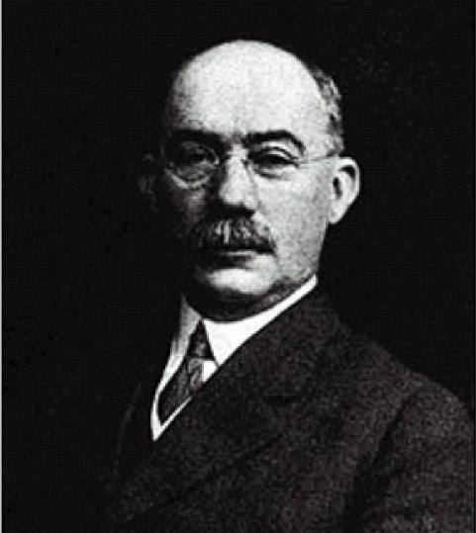
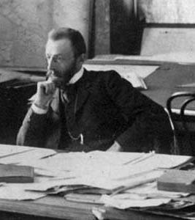

Slide 6
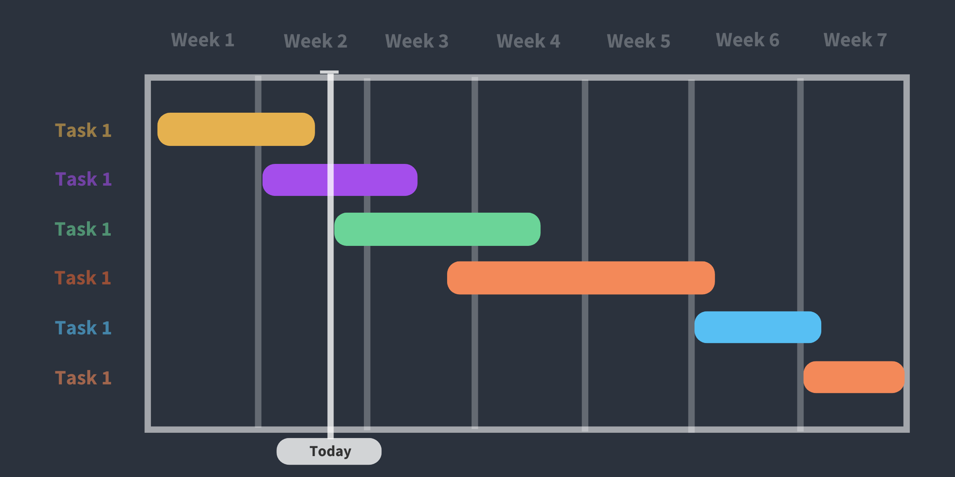

Slide 7

Constructing Gantt Charts
Key deadlines and milestones
Tasks
Start and end dates
Dependencies
Task owners/team members (multi-person teams)

Slide 8
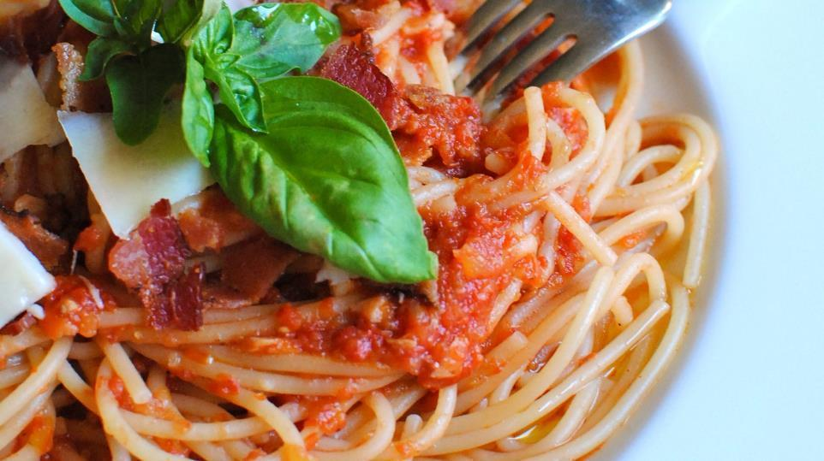

Slide 9
Constructing Gantt Charts
Key deadlines and milestones
Tasks
Start and end dates
Dependencies
Task owners/team members (multi-person teams)

Slide 10
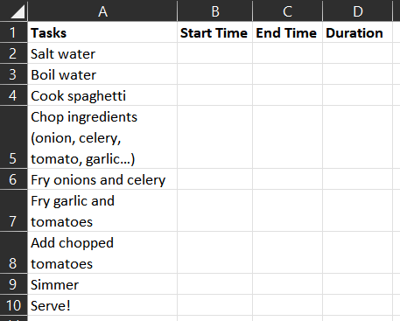
Constructing Gantt Charts: Cooking Spaghetti with Tomato Sauce
Tasks
List all of the tasks we can think of associated with the project

Slide 11
Constructing Gantt Charts
Key deadlines and milestones
Tasks
Start and end dates
Dependencies
Task owners/team members (multi-person teams)

Slide 12
Constructing Gantt Charts: Cooking Spaghetti with Tomato Sauce
Dependencies
Identify tasks we need to complete before we can move on to other tasks

Slide 13
Constructing Gantt Charts: Cooking Spaghetti with Tomato Sauce
Dependencies
Identify tasks we need to complete before we can move on to other tasks

Slide 14
Constructing Gantt Charts
Key deadlines and milestones
Tasks
Start and end dates
Dependencies
Task owners/team members (multi-person teams)

Slide 15
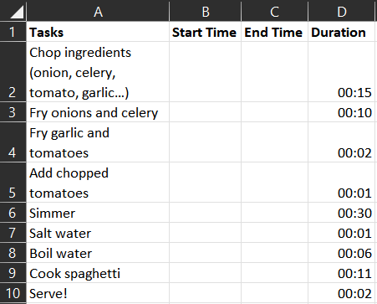
Constructing Gantt Charts: Cooking Spaghetti with Tomato Sauce
Estimate duration of each task
Important to be realistic – don’t list how long you would like the task to take!

Slide 16
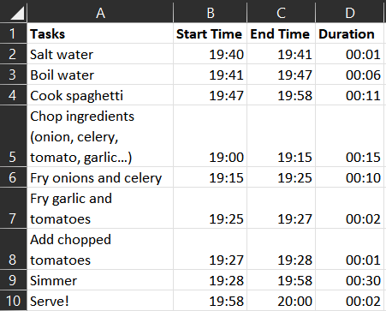
Constructing Gantt Charts: Cooking Spaghetti with Tomato Sauce
Estimate start and end times of each task based on duration
Set arbitrary deadline of 8pm (we want to have our dinner by 8pm)
Last task = serve
Work backwards to figure out what time we should start and end each task to meet our target of eating dinner at 8pm!
Don’t want our pasta to get cold!

Slide 17
Plot the Gantt chart
Sequential tasks until “simmer”…
Timeline visualisation: easy to view timeline, tasks, and dependencies
How to get critical path? (More on this later…)

Slide 18
Exercise 1
Creating a basic Gantt chart in Excel!
List all the tasks
Figure out dependencies
Determine start and end dates
Calculate task duration
Plot the Gantt chart
What task should I pick?
- A specific piece of coursework
- Managing coursework deadlines across the term
- A personal project
- Dissertation project

Slide 19
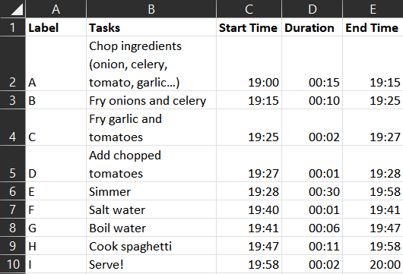
Critical path analysis
START
1m
6m
F
G
H
11m
I
A
B
C
D
E
30m
15m
10m
2m
1m
END

Slide 20
Critical path analysis
1m
6m
F
G
H
11m
START
I
END
A
B
C
D
E
30m
15m
10m
2m
1m
 | F
 | G
 | H
 | I
 | A
 | B
 | C
 | D
 | E

Slide 21
Critical path analysis
1m
6m
F
G
H
11m
START
I
END
A
B
C
D
E
30m
15m
10m
2m
1m
0 | F | 1
1 | G | 7
7 | H | 18
58 | I | 60
0 | A | 15
15 | B | 25
25 | C | 27
27 | D | 28
28 | E | 58

Slide 22
Critical path analysis
1m
6m
F
G
H
11m
START
I
END
A
B
C
D
E
30m
15m
10m
2m
1m
0 | F | 1
1 | G | 7
7 | H | 18
58 | I | 60
58 |  | 60
0 | A | 15
15 | B | 25
25 | C | 27
27 | D | 28
28 | E | 58

Slide 23
Critical path analysis
1m
6m
F
G
H
11m
START
I
END
A
B
C
D
E
30m
15m
10m
2m
1m
0 | F | 1
45 |  | 46
1 | G | 7
46 |  | 47
7 | H | 18
47 |  | 58
58 | I | 60
58 |  | 60
0 | A | 15
0 |  | 15
15 | B | 25
15 |  | 25
25 | C | 27
25 |  | 27
27 | D | 28
27 |  | 28
28 | E | 58
28 |  | 58

Slide 24
Critical path analysis
1m
6m
F
G
H
11m
START
I
END
A
B
C
D
E
30m
15m
10m
2m
1m
0 | F | 1
45 |  | 46
1 | G | 7
46 |  | 47
7 | H | 18
47 |  | 58
58 | I | 60
58 |  | 60
0 | A | 15
0 |  | 15
15 | B | 25
15 |  | 25
25 | C | 27
25 |  | 27
27 | D | 28
27 |  | 28
28 | E | 58
28 |  | 58
Critical Path: A→ B → C → D → E → I

Slide 25
Critical path analysis
1m
6m
F
G
H
11m
START
I
END
A
B
C
D
E
30m
15m
10m
2m
1m
0 | F | 1
45 |  | 46
1 | G | 7
46 |  | 47
7 | H | 18
47 |  | 58
58 | I | 60
58 |  | 60
0 | A | 15
0 |  | 15
15 | B | 25
15 |  | 25
25 | C | 27
25 |  | 27
27 | D | 28
27 |  | 28
28 | E | 58
28 |  | 58
Critical Path: A→ B → C → D → E → I
Your turn!

Slide 26
Gantt chart summary
Identify the critical path of a project
Compare progress with schedule
Easily visualise project timelines
Identify tasks to complete, and dependencies, at a glance
Good project overview!
How to complete these tasks? How to manage daily workload?

Slide 27
Pomodoro Technique
01
02
Gantt Chart
Pomodoro Technique

Slide 28

Notes:
For many of us, time is an enemy. Anxiety – often triggered by “the ticking clock” can result in unproductive habits and procrastination.
Fortunately for us, we have allies in the form of many different strategies to help us manage both our time and workload.

Slide 29

Notes:
The Pomodoro technique is one such technique.

Slide 30
Notes:
Pomodoro is Italian for tomato, and this strategy was named this way by its creator: XX due to the shape of the kitchen timer originally used.

Slide 31
The Pomodoro Technique
What actually is a pomodoro?
25 mins
5 mins
Notes:
So what actually is a pomodoro in this context?
A pomodoro is 30 minute long block, which consists of 25 minutes work, and 5 minutes break.

Slide 32
The Pomodoro Technique
Pomodoro after pomodoro
4 x pomodoro = 1 block
Notes:
We will stack pomodoros together, in groups of three or four – here on the slide we’ve shown four. After our four pomodoros we will take a slightly longer 15-30 minute break.

Slide 33
Pomodoro Process
What | When | Why
Planning | At the start of the day | To decide on the day’s activities
Tracking | Throughout the day | To gather data about effort and achievement
Recording | At the end of the day | Build an archive of observations
Processing |  | Analyse data, and get information
Visualising |  | Present information in a format so that we can improve our skills
Notes:
Having gone over how we will work – let’s consider how best to go about deciding what we will work on.
This is an overview of the 5 stages of the pomodoro.

Slide 34
Pomodoro Process
What | When | Why
Planning | At the start of the day | To decide on the day’s activities
Tracking | Throughout the day | To gather data about effort and achievement
Recording | At the end of the day | Build an archive of observations
Processing |  | Analyse data, and get information
Visualising |  | Present information in a format so that we can improve our skills
Notes:
We’ll begin by looking at planning the day – and how to decide on what things we will work on.

Slide 35
Planning the Day
List of everything that we need to do – in no particular order.
The Activity Inventory Sheet
Date | Time | Activity | Est PD | Actual PD
Notes:
To do that, we will introduce the Activity Inventory Sheet. And we’ll take a brief pause from me presenting here, to give everyone in the session the chance to take part… so if everyone can come and grab a sheet.
We’re going to start by looking only at the Activity column – and for the next 5 minutes, please write down everything that you can think of that you need to do. So maybe that’s working on certain labs, or revising some material before class, and so on…

Slide 36
Planning the Day
List of everything that we need to do – in no particular order.
The Activity Inventory Sheet
Date | Time | Activity | Est PD | Actual PD
 |  | Review CNN outputs and loss function plots, integrate to PP
 |  | Test trained CNN models on validation data, write results up in PP
 |  | Revise material to design new CNN models
Notes:
So I’ve taken a few things off my Activity Inventory sheet to show here. What we want to do next, is fill in the “Estimated Pomodoros” column – so this is how many pomodoros we think the task will take us to complete.

Slide 37
Planning the Day
List of everything that we need to do – in no particular order.
The Activity Inventory Sheet
Date | Time | Activity | Est PD | Actual PD
 |  | Review CNN outputs and loss function plots, integrate to PP | 1
 |  | Test trained CNN models on validation data, write results up in PP | 1
 |  | Revise material to design new CNN models | 2
Notes:
So I’ve added some estimates here.

Slide 38
The Pomodoro Technique
What actually is a pomodoro?
Nothing smaller than a pomodoro
25 mins
5 mins
Your turn! Fill in the Estimated Pomodoro column in your Activity Inventory sheet.
Notes:
One pomodoro is an atomic unit of time, and it cannot be divided!
So in this 25 minutes, we must work consistently, without stopped. An interrupted pomodoro does not count as a completed pomodoro!

Slide 39
Planning the Day
List of everything that we need to do – in no particular order.
The Activity Inventory Sheet
Date | Time | Activity | Est PD | Actual PD
 |  | Review CNN outputs and loss function plots, integrate to PP | 1
 |  | Test trained model CNN models on validation data, write results up in PP | 1
 |  | Revise material to design new CNN models | 2
No tasks longer than 5-7 pomodoros! >> Break it down!
Notes:
So I’ve added some estimates here.

Slide 40
Planning the Day
To Do Today sheet
Activity | Record | Est PD | Actual PD

Slide 41
Planning the Day
Fill out before you start working, every single day!
To Do Today sheet
Activity | Record | Est PD | Actual PD

Slide 42
Planning the Day
Fill out before you start working, every single day!
To Do Today sheet
Activity | Record | Est PD | Actual PD
Review CNN outputs and loss function plots, integrate to PP |  | 1
Test trained model CNN models on validation data, write results up in PP |  | 1
Revise material to design new CNN models |  | 2

Slide 43
Estimated timetable
8-hour workday
16 pomodoros
Time | Pomodoro Block
08:00 – 10:00 | 1
10:30 – 12:30 | 2
13.30 – 15:30 | 3
16:00 – 18:00 | 4
7-hour workday
14 pomodoros
Time | Pomodoro Block
08:00 – 10:00 | 1
10:30 – 12:00 | 2
13.00 – 15:00 | 3
15:30 – 17:00 | 4

Slide 44
Estimated timetable
Your turn!
Plan a timetable for Monday next week:
What are your working hours?
When will you take breaks
Lectures/meetings should be taken into account

Slide 45
Estimated timetable
Your turn!
Plan a timetable for Monday next week:
What are your working hours?
When will you take breaks
Lectures/meetings should be taken into account
How do we decide what to work on?

Slide 46
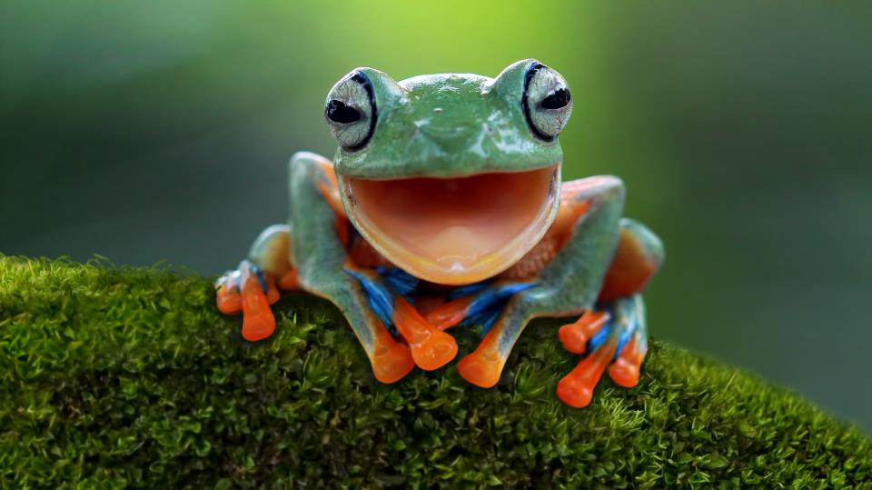

Slide 47
If it's your job to eat a frog, it's best to do it first thing in the morning. And If it's your job to eat two frogs, it's best to eat the biggest one first.
Mark Twain

Slide 48
Planning the Day
Fill out before you start working, every single day!
To Do Today sheet
Activity | Record | Est PD | Actual PD
Review CNN outputs and loss function plots, integrate to PP |  | 1
Test trained model CNN models on validation data, write results up in PP |  | 1
Revise material to design new CNN models |  | 2

Slide 49
Planning the Day
Fill out before you start working, every single day!
To Do Today sheet
Activity | Record | Est PD | Actual PD
Review CNN outputs and loss function plots, integrate to PP |  | 1
Test trained model CNN models on validation data, write results up in PP |  | 1
Revise material to design new CNN models |  | 2
Your turn! Fill out your To Do Today sheet (for Monday next week). Pick out which tasks you will do – making sure not to exceed the number of pomodoros you have available.

Slide 50
Pomodoro Process
What | When | Why
Planning | At the start of the day | To decide on the day’s activities
Tracking | Throughout the day | To gather data about effort and achievement
Recording | At the end of the day | Build an archive of observations
Processing |  | Analyse data, and get information
Visualising |  | Present information in a format so that we can improve our skills

Slide 51



Pomodoro Process
Activity | Record | Est PD | Actual PD
Review CNN outputs and loss function plots, integrate to PP |  | 1
Test trained model CNN models on validation data, write results up in PP |  | 1
Revise material to design new CNN models |  | 2
Notes:
Start working. After each pomodoro take a short break (3-5 mintes). Mark each completed pomodoro with an X on the To Do Today sheet.

Slide 52
Pomodoro Process
Activity | Record | Est PD | Actual PD
Review CNN outputs and loss function plots, integrate to PP | X | 1
Test trained model CNN models on validation data, write results up in PP |  | 1
Revise material to design new CNN models |  | 2
Notes:
Start working. After each pomodoro take a short break (3-5 mintes). Mark each completed pomodoro with an X on the To Do Today sheet.

Slide 53
Pomodoro Process
Activity | Record | Est PD | Actual PD
Review CNN outputs and loss function plots, integrate to PP | XX | 1
Test trained model CNN models on validation data, write results up in PP |  | 1
Revise material to design new CNN models |  | 2
Notes:
Start working. After each pomodoro take a short break (3-5 mintes). Mark each completed pomodoro with an X on the To Do Today sheet.

Slide 54
Pomodoro Process
Activity | Record | Est PD | Actual PD
Review CNN outputs and loss function plots, integrate to PP | XX | 1 | 2
Test trained model CNN models on validation data, write results up in PP |  | 1
Revise material to design new CNN models |  | 2
Notes:
After four pomodoros, take a longer break (15-30 minutes).
When you complete a task, cross it out on the To Do Today sheet.

Slide 55
Pomodoro Process
Activity | Record | Est PD | Actual PD
Review CNN outputs and loss function plots, integrate to PP | XX | 1 | 2
Test trained model CNN models on validation data, write results up in PP | X | 1 | 1
Revise material to design new CNN models | XXX | 2 | 3
Notes:
After four pomodoros, take a longer break (15-30 minutes).
When you complete a task, cross it out on the To Do Today sheet.

Slide 56
Pomodoro Process
What | When | Why
Planning | At the start of the day | To decide on the day’s activities
Tracking | Throughout the day | To gather data about effort and achievement
Recording | At the end of the day | Build an archive of observations
Processing |  | Analyse data, and get information
Visualising |  | Present information in a format so that we can improve our skills
Notes:
How did the day go? What went well, what could have gone better?
How many pomodoros were achieved?
How many interruptions did you have? External or internal?
Do you need to update your estimates in the activity inventory sheet in light of today’s efforts?
Over time, track trends…

Slide 57
Key Rules
A pomodoro consists of 25 minutes + 5 minute break
After every four pomodoros is a 15-30 minute break
The pomodoro is an atomic unit of time and cannot be divided
If more than 5-7 pomodoros, break it down!
If less than 1 pomodoro, add it up!

Slide 58
Key Rules
A pomodoro consists of 25 minutes + 5 minute break
After every four pomodoros is a 15-30 minute break
The pomodoro is an atomic unit of time and cannot be divided
If more than 5-7 pomodoros, break it down!
If less than 1 pomodoro, add it up!
An interrupted pomodoro is an invalid pomodoro
If the pomodoro begins, it must ring.

Slide 59


Slide 60
Managing Interruptions
Internal Interruptions
External Interruptions
“I need to get a drink.”/”I’m hungry.”
“I should call Dave back.”
“I need to debug my code for the lab class.”
“I need to check a deadline.”
“Would you like to come and get some food?”
“Hey, call me back!”
“Could you go over the answer to XYZ?”

Slide 61
Managing Interruptions
Internal Interruptions
External Interruptions
“I need to get a drink.”/”I’m hungry.”
“I should call Dave back.”
“I need to debug my code for the lab class.”
“I need to check a deadline.”
“Would you like to come and get some food?”
“Hey, call me back!”
“Could you go over the answer to XYZ?”

Slide 62
Managing Interruptions
Internal Interruptions
Activity | Record | Est PD | Actual PD
Review CNN outputs and loss function plots, integrate to PP | XX | 1 | 2
Test trained CNN models on validation data, write results up in PP |  | 1
Revise material to design new CNN models |  | 2
“I need to get a drink.”/”I’m hungry.”
“I should call Dave back.”
“I need to debug my code for the lab class.”
“I need to check a deadline.”

Slide 63
Managing Interruptions
Internal Interruptions
Activity | Record | Est PD | Actual PD
Review CNN outputs and loss function plots, integrate to PP | XX | 1 | 2
Test trained CNN models on validation data, write results up in PP | ‘ | 1
Revise material to design new CNN models |  | 2
“I need to get a drink.”/”I’m hungry.”
“I should call Dave back.”
“I need to debug my code for the lab class.”
“I need to check a deadline.”

Slide 64
Managing Interruptions
Internal Interruptions
Activity | Record | Est PD | Actual PD
Review CNN outputs and loss function plots, integrate to PP | XX | 1 | 2
Test trained CNN models on validation data, write results up in PP | ‘ | 1
Revise material to design new CNN models |  | 2
URGENT AND UNPLANNED
Debug code for lab class
“I need to get a drink.”/”I’m hungry.”
“I should call Dave back.”
“I need to debug my code for the lab class.”
“I need to check a deadline.”

Slide 65
Managing Interruptions
Internal Interruptions
Activity | Record | Est PD | Actual PD
Review CNN outputs and loss function plots, integrate to PP | XX | 1 | 2
Test trained CNN models on validation data, write results up in PP | ‘’ | 1
Revise material to design new CNN models |  | 2
URGENT AND UNPLANNED
Debug code for lab class
Call Dave back
“I need to get a drink.”/”I’m hungry.”
“I should call Dave back.”
“I need to debug my code for the lab class.”
“I need to check a deadline.”

Slide 66
Managing Interruptions
Internal Interruptions
Activity | Record | Est PD | Actual PD
Review CNN outputs and loss function plots, integrate to PP | XX | 1 | 2
Test trained CNN models on validation data, write results up in PP | ‘’ | 1
Revise material to design new CNN models |  | 2
URGENT AND UNPLANNED
Debug code for lab class
Call Dave back
“I need to get a drink.”/”I’m hungry.”
“I should call Dave back.”
“I need to debug my code for the lab class.”
“I need to check a deadline.”
Notes:
Highlighted items we can do during the breaks between Pomodoros or between Pomodoro blocks depending on how likely they are to take.

Slide 67
Managing Interruptions
Internal Interruptions
Activity | Record | Est PD | Actual PD
Review CNN outputs and loss function plots, integrate to PP | XX | 1 | 2
Test trained CNN models on validation data, write results up in PP | ‘’ | 1
Revise material to design new CNN models |  | 2
URGENT AND UNPLANNED
Debug code for lab class
Call Dave back
“I need to get a drink.”/”I’m hungry.”
“I should call Dave back.”
“I need to debug my code for the lab class.”
“I need to check a deadline.”
Notes:
For bigger tasks like “debugging code for the lab class”, we need to add this to our Activity Inventory. We’ll deal with these tasks later by scheduling time for them.

Slide 68
Managing Interruptions
Internal Interruptions
External Interruptions
“I need to get a drink.”/”I’m hungry.”
“I should call Dave back.”
“I need to debug my code for the lab class.”
“I need to check a deadline.”
“Would you like to come and get some food?”
“Hey, call me back!”
“Could you go over the answer to XYZ?”

Slide 69


Managing Interruptions
External Interruptions
“Would you like to come and get some food?”
“Hey, call me back!”
“Could you go over the answer to XYZ?”
Notes:
Be proactive about limiting external interruptions: keep Whatsapp Web on mute, and minimise notifications being shown while you are working. Try and find somewhere to work that has minimal distractions.

Slide 70
Managing Interruptions
Inform
Negotiate
Call back
External Interruptions
“Would you like to come and get some food?”
“Hey, call me back!”
“Could you go over the answer to XYZ?”

Slide 71
Managing Interruptions
Activity | Record | Est PD | Actual PD
Review CNN outputs and loss function plots, integrate to PP | XX | 1 | 2
Test trained model CNN models on validation data, write results up in PP | ‘’- | 1
Revise material to design new CNN models |  | 2
URGENT AND UNPLANNED
Debug code for lab class
Call Dave back
Get some food with a friend
External Interruptions
“Would you like to come and get some food?”
“Hey, call me back!”
“Could you go over the answer to XYZ?”
Notes:
For bigger tasks like “debugging code for the lab class”, we need to add this to our Activity Inventory. We’ll deal with these tasks later by scheduling time for them.

Slide 72
Summary
Mark internal interruptions with an apostrophe
Mark external interruptions with a dash
Reschedule interruptions for your short/long breaks (depending on how long they might take), or even make specific pomodoros for them!
Or add interruptions to your Activity Inventory sheet to complete them on another day

Slide 73


Slide 74


Slide 75
Don’t forget to rest!
Work long/late hours
Fatigue Increases
Productivity Drops
The Burnout Circle

Slide 76
Don’t forget to rest!
Work long/late hours
Fatigue Increases
Productivity Drops
Set a cut-off period after which you do no work!
The Burnout Circle

Slide 77
Don’t forget to rest!
Work long/late hours
Fatigue Increases
Productivity Drops
Set a cut-off period after which you do no work!
Timetables:
8.00-10.00, 10.30-12.30, 13.30-15.30, 16.00-18.00; no work after 6pm!
11.00-13.00, 14.00-16.00, 16.30-18.30, 19.00-21.00; no work after 9pm!
The Burnout Circle

Slide 78
Managing Overtime
Overtime and extra hours can be used to momentarily increase productivity
To avoid the burnout spiral, try not to work overtime for more than five days
Establish an ad-hoc timetable for this period
Set aside recovery time (a drop in productivity will likely follow this overtime)

Slide 79


Slide 80
Summary
A pomodoro consists of 25 minutes + 5 minute break
After every four pomodoros is a 15-30 minute break
The pomodoro is an atomic unit of time and cannot be divided
If more than 5-7 pomodoros, break it down!
If less than 1 pomodoro, add it up!
An interrupted pomodoro is an invalid pomodoro
If the pomodoro begins, it must ring.
Results come pomodoro after pomodoro.
The next pomodoro will be better.

Slide 81
Resources
Presentation
Excel Gantt chart
Activity Inventory Sheet
To Do Today sheet
Pomodoro Technique summary notes

